Slide 1
Lec - 2

Slide 2
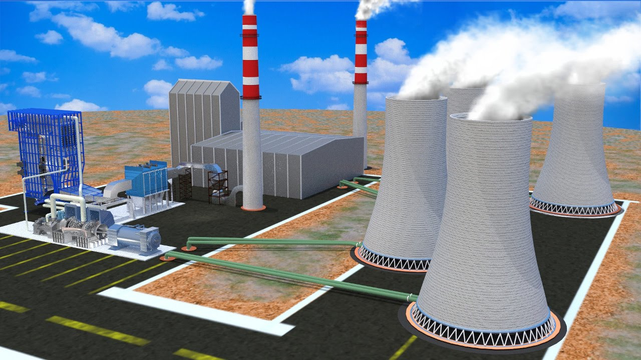
THERMAL
POWER PLANT
FOSSIL FUELS
ELECTRICITY
MECHANICAL
ENERGY
HEAT
STEAM
ELECTRICITY
Why are thermal power plants set up near coal or oil fields?
Transmission of electricity is more efficient than transporting coal or petroleum over the same distance

Slide 3
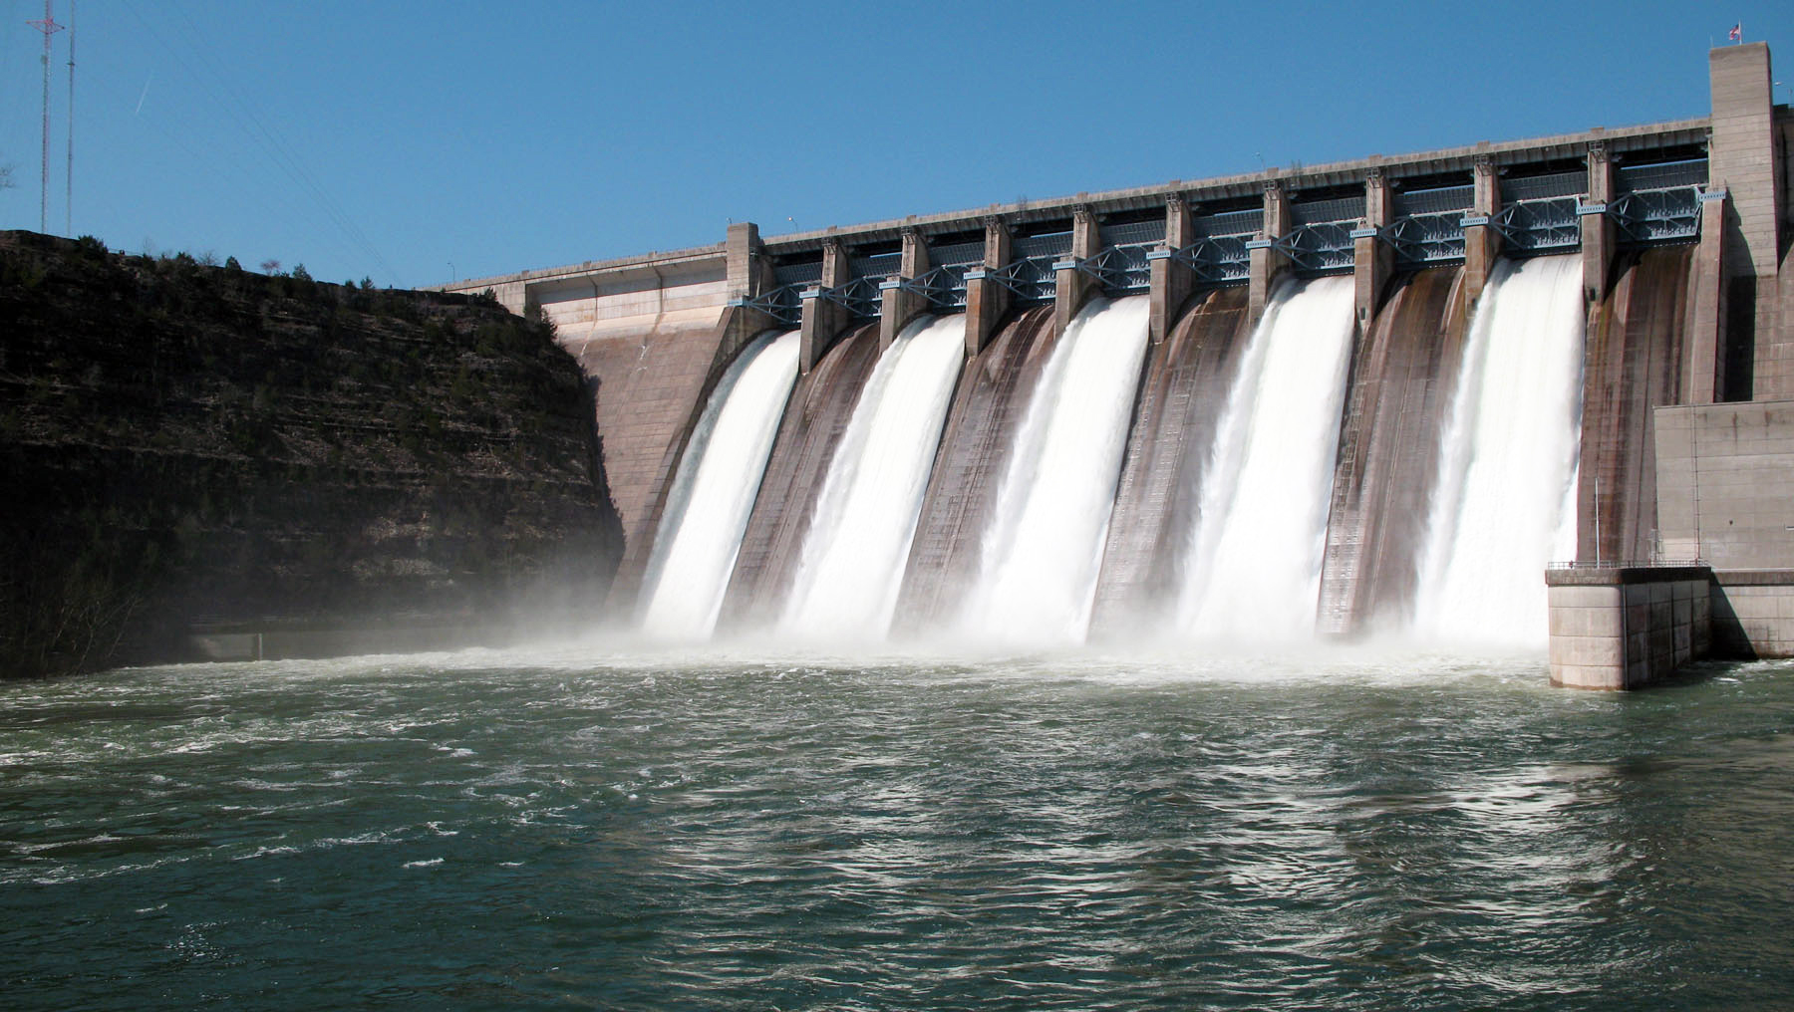
HYDRO ELECTRIC
POWER STATION

Slide 4
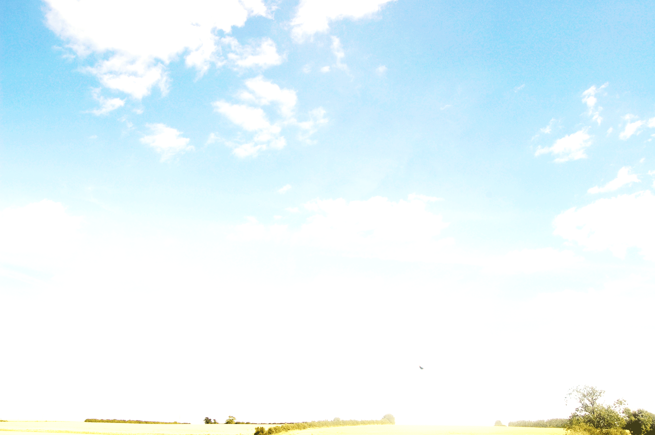


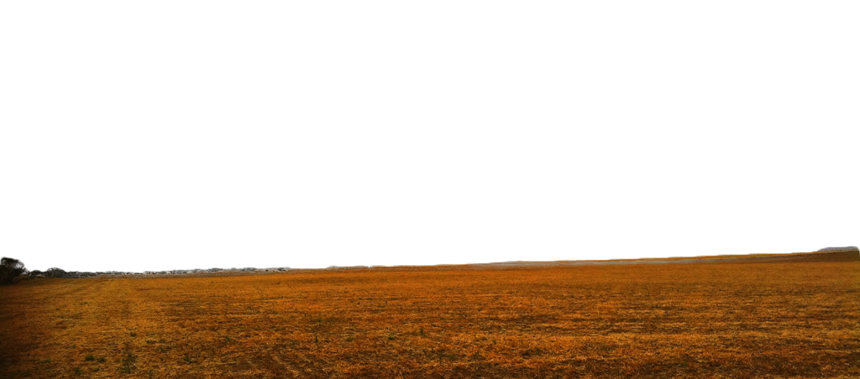


HYDROELECTRIC POWER PLANT
Different Stages in hydroelectric power plant
Generator
Power house
Wall
Generator
Potential
Energy
Electrical
energy
Dam gate
Reservoir
Kinetic Energy
Water reservoir with
potential energy
Water turbine
Turbine

Slide 5
HYDROELECTRIC POWER PLANT
Energy Transformation in hydroelectric power plant
Potential energy
in water
Kinetic energy in flowing water
Kinetic energy
in turbine
Electrical
energy
Power house
Wall
Generator
Potential
Energy
Sluice gates
Reservoir
Kinetic Energy
Penstock
Turbine

Slide 6

ADVANTAGES OF USING THE
HYDRO ENERGY
It does not produce any environmental pollution.
It is a renewable source of energy.
The dam constructed over river help in irrigation and control of floods in river.
LIMITATIONS OF USING
HYDRO ENERGY
The vegetation which is submerged rots under anaerobic conditions and generates methane (green-house gas).
The ecological balance in the downstream areas of rivers gets disturbed.

Slide 7
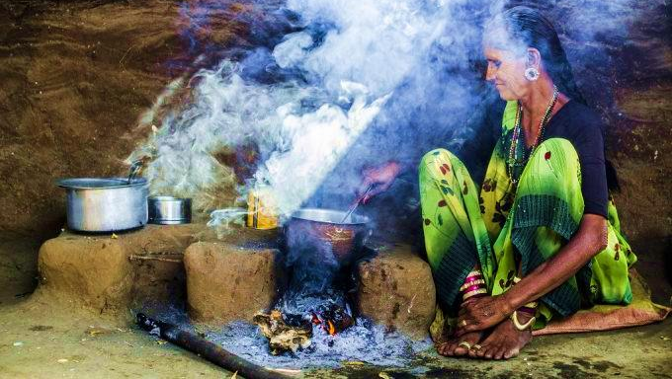
WOOD AS
FUEL

Slide 8

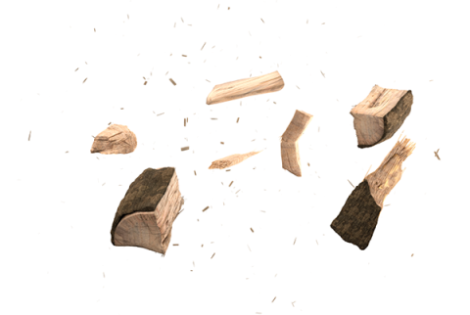

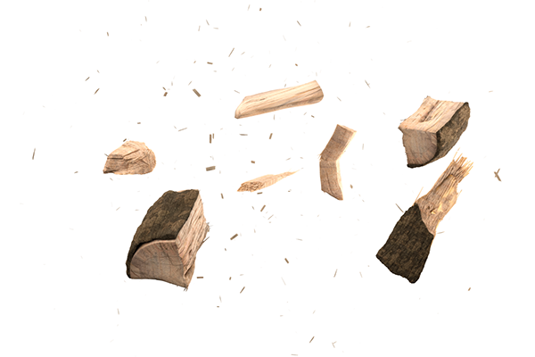
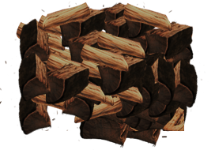
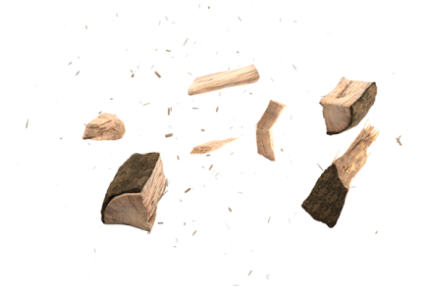
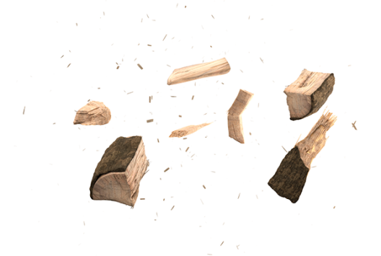
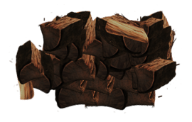
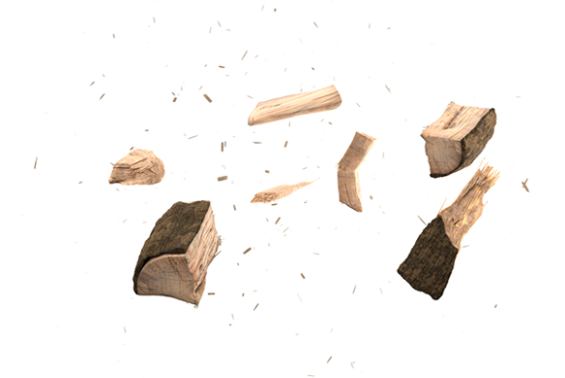
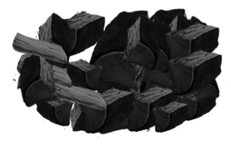


When wood is burnt in a limited supply of oxygen it forms CHARCOAL
Charcoal burns without flames, smoke and has a high calorific value
CHARCOAL

Slide 9
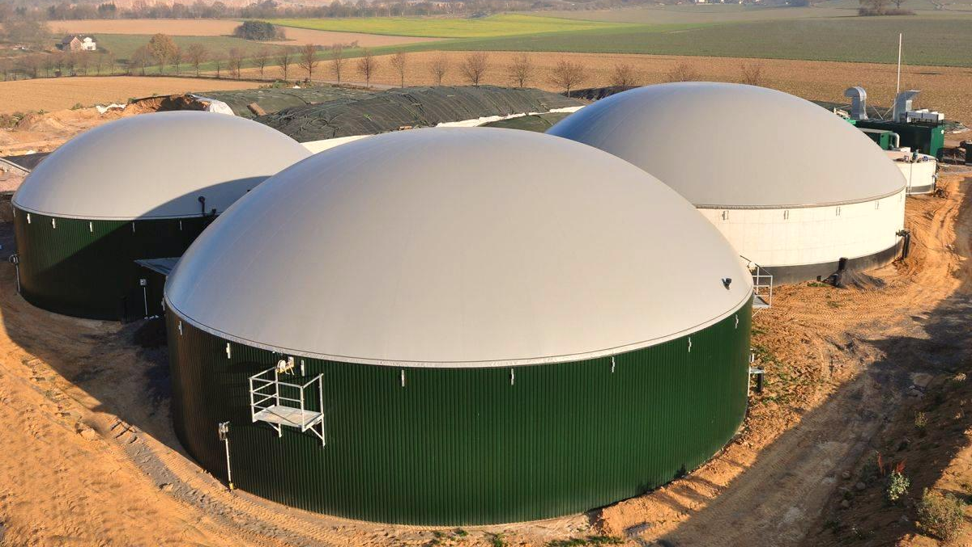
The wastes and dead parts of living beings like plants, trees and animals, is called bio mass.
Bio mass
Bio gas (Gobar gas
75% Methane)
BIO MASS

Slide 10


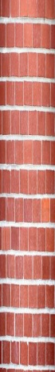
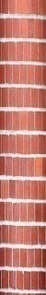
BIOGAS PLANT
Gas Outlet
Sludge is used as manure (rich in nitrogen and phosphorus)
Mixing Tank
Dung + Water
Overflow Tank
Slurry
Outlet
Pipe
Ground
Partition Wall
Ground
Intel Pipe
Sludge is pushed to the over flow tank
Biogas is produced which is a mixture of methane, carbon dioxide, hydrogen and H2S
Digester is a sealed chamber which is underground
Digester
slurry under goes anaerobic decomposition

Slide 11
Thank You

